Slide 1
Autumn 2024
Advanced Programming
(C Programming Language)

Slide 2
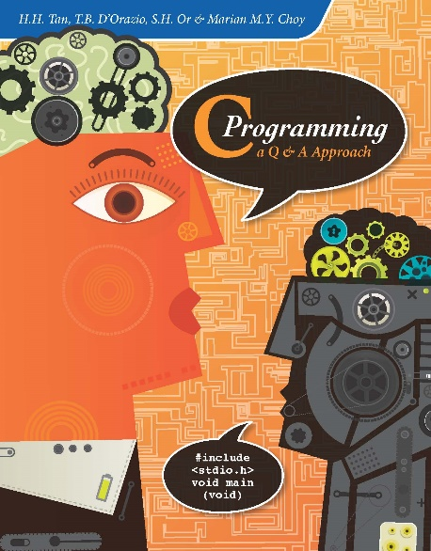
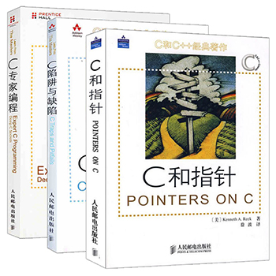
Textbook:
C programming: a Q&A approach---- H.H. Tan T.B. D Orazio S.H. Or Marian M. Y. Choy
Reference book:
The C Programming Language
C primer plus

Slide 3
Assessment methods and evaluation of results
1. Examination methods: examination + kinds of accomplishments + experiment is composed of three parts.
2. Evaluates: the course examination 5０%, accomplishments, experiment accounted for 25% and 25% forms.

Slide 4
Chapter One
Programming Fundamentals

Slide 5

Outline
Overview of Programs and Algorithms
Overview of C Language
    Programming language
    Characteristics of C
    Essential Elements
    Simple Programming Examples
How to do programming?
    Programming Process
    Programming Environment
    Programming style

Slide 6








Overview of Programs and Algorithms
What’s Computer System?
Hardware
Software
Computer
system
Notes:
本课程是编程语言，最终目的是用这种语言编制程序来和计算机交流，所以这里首先介绍什么是程序，什么是程序语言。计算机程序就是一系列计算机指令的集合。每个指令会指挥计算机执行不同的操作。编制程序的工作就是为计算机安排指令序列。编程语言就是用来书写这些指令的语言。软件，程序，编程语言的关系。

Slide 7
Simply describe how the computer works
Company Logo
calculator
111010011110
feedback
operate
1
or
0
1
or
0
Output results
memorizer
program
Input quipment
output quipment
1101000110
101100011110
011001001111
100110011011
data
97，中国，图片视频
data
128，西大，图片视频语音
1
or
0
address
instruction
1
or
0
1
or
0
signal
signal
1
or
0
controller
control signal
110101011010
control signal
request signal
request signal
控制器识别规定的二进制串代表的指令
001110010 要求运算器执行加法运算
001110001 要求运算器执行减法运算
111001100 要求运算器执行乘法运算
110011001 要求运算器执行除法运算
111111000 要求运算器执行逻辑运算
存储器中存储的是指令序列构成的程序，
汇编语言中要讲具体指令功能与数据信息

Slide 8

diagram of the program execution in the computer
Disk Logic Performance
notepad.exe
The program loaded into the computer memory is generally divided into two parts
byte=
8 bit
从内存一次读一条指令到CPU执行，然后再读下一条指令执行
net card
A program on the disk
10011011
10100101
01100011
10101010
11111111
00000000
11100011
10100010
????????
????????
????????
????????
????????
????????
1、instructions sequence of program
keyboard
A program on the disk
指令执行时需要的数据再从内存将数据读到CPU计算，或者把计算结果写到内存
2、data needed by the program
mouse

Slide 9

Overview of Programs and Algorithms
What is Program?
statements
Program ->A list of computer instructions
Program = Data Structure + Algorithm +
Language
Program Design
Software
program
data
document
programming
language
A set of programs
A set of Characters and rules
Can be interpreted by Computer
Notes:
本课程是编程语言，最终目的是用这种语言编制程序来和计算机交流，所以这里首先介绍什么是程序，什么是程序语言。计算机程序就是一系列计算机指令的集合。每个指令会指挥计算机执行不同的操作。编制程序的工作就是为计算机安排指令序列。编程语言就是用来书写这些指令的语言。软件，程序，编程语言的关系。

Slide 10
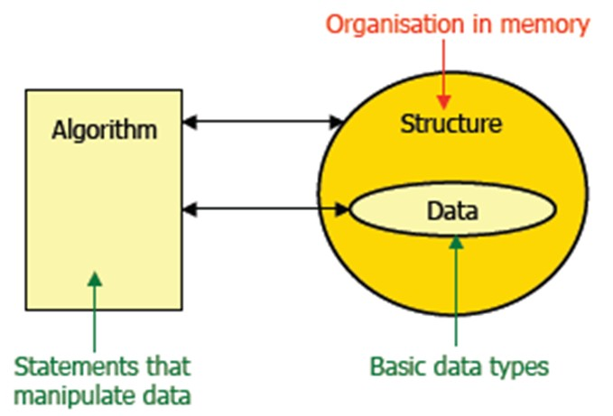
Data, structure, algorithm
  integer x=3,y=5,z;
  if(x>0)
  z=y/2;
  else
  z=y%2;
  Data in the program
  instruction sequence consisting program algorithm

Slide 11
Overview of Programs and Algorithms
Program design-> How to solve the problem
algorithmic design + coding
e.g
Have several method to calculate？
1、The sum of the values from 1 to 100
2、the area of a swimming pool?
Notes:
问一个问题：大家都使用过计算机没有，都用来干什么？上网，玩游戏，听音乐，看电影，查资料，美术设计。。。
程序设计就是编写不同功能的程序的过程。
更具体地说，就是用计算机语言对所要解决的问题中的数据（数据结构）以及处理问题的方法和步骤（算法）所做的完整而准确的描述。这个描述过程就称为程序设计。
程序设计的四个步骤：
（1）分析问题，建立数学模型；
（2）确定数据结构和算法
（3）编制程序
（4）调试程序
由此可见在用语言编程过程中，算法起着至关重要的作用。那么什么是算法？

Slide 12
Overview of Programs and Algorithms
four steps Program design
Steps
Keywords
Analyze
Based on math knowledge
Problem Model
Confirm
Data structure and Algorithm
Coding
Programming language
Debug
Result

Slide 13
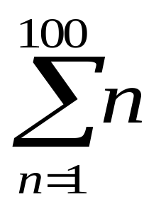

What is Algorithm (算法)
Overview of Programs and Algorithms
-> A strategy for solving a problem
(a list of steps)
e.g： Y =
Algorithm must be:
  Clearly and unambiguously defined.
  Effective, in the sense that its steps are executable.
  Finite, in the sense that it terminates after a bounded number of steps
Notes:
算法由基本功能操作和控制结构这两个要素组成。

Slide 14
Overview of Programs and Algorithms
Essential factors: Operator + Control
Arithmetic Operator: ＋ － × ÷
Logical Operator: and, or, not
Operator
Relational Operator: ＞ ＜ ≥ ≤ ≡ ≠
Transmit Operator: input, output, assign
sequence （顺序）
Control
decision (branch)（分支/选择）
repetition (loop)（循环）
Notes:
算法由基本功能操作和控制结构这两个要素组成。

Slide 15
Overview of Programs and Algorithms
Practical Problems:
There is a black ink bottle and a blue one, But Lily filled black ink into the blue bottle and blue ink into the black one by mistake. How to exchange them to the write bottle?

Slide 16
Analysis
analogy
ink
real data
A blank bottle needed
bottle
variables
Step1: Get a blank red bottle.
Step2: Pouring blue ink from black bottle into the red one.
Step3: Pouring black ink from blue bottle into the black one.
Step4: Pouring blue ink from red bottle into the blue one.
Step5: End.

Slide 17
Overview of Programs and Algorithms
Presenting Algorithm
Some Presenting Forms:
Human Language
Flowchart
Pseudo-code

Slide 18
Overview of Programs and Algorithms
Symbols in Flowchart Provided by ANSI (American National Standard Institute)
begin
input a,b
a->c
Begin&end
decision
process
e.g
Swapping
two variables
b->a
input/output
Link point
c->b
output a,b
end
comment
Flow direction

Slide 19
Outline
Overview of Programs and Algorithms
Overview of C Language
    Programming Language
    Characteristics of C
    Essential Elements
    Simple Programming Examples
How to do programming?
    Programming Process
    Programming Environment
    Programming style

Slide 20


Programming Language
Natural Language
  Human & Human Communication
Programming Language
  Human & Computer Communication
  A set of Characters and rules
  Strict rules
  Can be interpreted by Computer
Chinese,
English,
Japanese,
……
Grammar
(语法)
Meaning
(意思)
Syntax
(语法)
Semantics
(语义)
Fortran,
B, Pascal,
C, C++,
Java, ……
Notes:
规定字符集
严格规定的规则
能用计算机解释理解

Slide 21
Syntax & semantics
Overview of C Language
Both Natural language and Programming language have syntax (语法) and semantics (语义).
The syntax of a programming language is concerned with the form of programs.
The semantics of a programming language is concerned with the meaning of programs.
Notes:
编程语言的语法与程序的形式有关

Slide 22
e.g. Implementations of 1+1 in 5 languages
C language
#include <stdio.h>
  main( )
  {
    printf("%d\n", 1+1);
  }
C++ language
  #include <iostream>
main()‏
{
std::cout << 1 + 1;
}
Machine language
  10111000
  00000001
  00000000
  00000101
  00000001
  00000000
Assembly language
  MOV AX, 1
  ADD AX, 1
Basic language
PRINT 1+1

Slide 23
The development of Programming language
1960 Algol-60
1950
1963 CPL
Fortran
1960
Algol-60
Cobol
1967 BCPL
CPL
Simula
BCPL
1970
B
1970
Pascal
B
Smalltalk
C
1972
C
1980
Ada
C++
1985
C++
ANSI C
1990
Java
Notes:
C的前辈语言：Algol68，CPL，BCPL，B。
1960年1月，图灵奖获得者:艾伦.佩利（Alan J.Perlis）在巴黎举行的有全世界一流软件专家参加的讨论会上，发表了“算法语言Algol 60报告”，确定了程序设计语言的基础。
CPL（Combined Programming language，组合编程语言)：CPL是一种在ALGOL60基础上更接近硬件的一种语言。CPL规模大，实现困难。
BCPL（Basic Combined Programming language，基本的组合编程语言）：BCPL是对CPL进行简化后的一种语言。
B语言大约是于1969年时由美国贝尔实验室的电脑科学家肯·汤普森在丹尼斯·利奇的支持下设计出来的。
丹尼斯·利奇以B语言为基础开发出C语言
ANSI（Americal national standard institute）：美国国家标准化组织。
计算机语言按照使用方式和功能分为低级语言和高级语言。
低级包括机器语言和汇编语言。
机器语言是计算机指令的集合，是第一代计算机语言。
汇编语言用符号来表示计算机指令，是第二代计算机语言。
二者都是面向机器的语言。
用自然语言的形式描述对问题的处理过程，用数学表达式的形式描述对数据的计算过程。高级语言，不关心计算机的内部机构，面向过程的语言，如Basic, Fortran, Cobol, C, Pascal.告诉计算机怎么做。
第四代非过程化语言，只需告诉计算机做什么，是面向对象的语言。
第五代智能语言

Slide 24
Overview of C Language
What is C?
Operating systems, Compiler, Drivers…
a general-purpose computer programming language
characters, syntax, structure, control statement, data type, operators…

Slide 25
Overview of C Language
Characteristics of C
Small size
C is modular
Loose typing
Structured language
Low level programming readily available
C has a very powerful set of operators
C is the basis for C++ and Java
C efficient on most machines
Notes:
（1）编制程序过程中，小就意味着美。（small is beautiful in programming.）有更少的关键字。
(2)C语言既可以用来书写操作系统，也可以用来开发其他应用程序。如MS-dos就是用C写的。还有许多数据库程序，图形库函数等都用C来书写。
（3）C具有很强的可移植性。C有内置的前处理器，可以使编制的程序独立于系统运行，可用于各种不同的计算机。
（4）C是简练的。运算符达30种，涉及的范围广，功能强。可直接处理字符，访问内存物理地址，进行位操作，
（5）C是模块化的。
（6）C是C++和JAVA的基础
（7）C是一种运行效率比较高的代码
（8）C有超强的算子和无拘无束的天性。
可进行内存物理地址访问，具有汇编语言的特点。
控制流程结构化，以函数为基本结构进行流程控制
具有构造数据类型的能力，数据结构系统化
语言简洁灵活，有32个关键字(附录2)和9种控制语句
语言表达能力强：34种运算符（附录3）
程序运行效率高，易读性、可移植性好

Slide 26
C Program Structure
Overview of C Language
program
functions
statements
expressions
Characters
Operands + operators

Slide 27
Essential Elements
Numeral: 0 1 2 … 9
Letter: ABC…Z a b c…z
Character
Operator: + - = > < …
Others: \r \n \t …
Expression
branch: if-else; switch
loop: for; while
Jump: break; goto…
Statement
Control
Compound
Function:
main( ), print(…)
Notes:
Character:基本字符集
Others:特殊字符和不可显示字符：空格，换行，制表符
Statement:语句

Slide 28
Software Engineering
The process of software development
Should be thoroughly thought out, planned, constructed, and tested
  Define function of the software
  Develop sketch of the layout
  Input from users, owners, programmers, etc. are solicited
  Design of individual components is addressed
  Planning modifications and assemble the software and test for functionality
  Comprehensively tested and modified as necessary
  Documentation about the software is maintained
Notes:
应该彻底考虑、计划、建造和测试
绘制布局草图
讨论单个组件的设计
计划修改和组装软件和功能测试

Slide 29
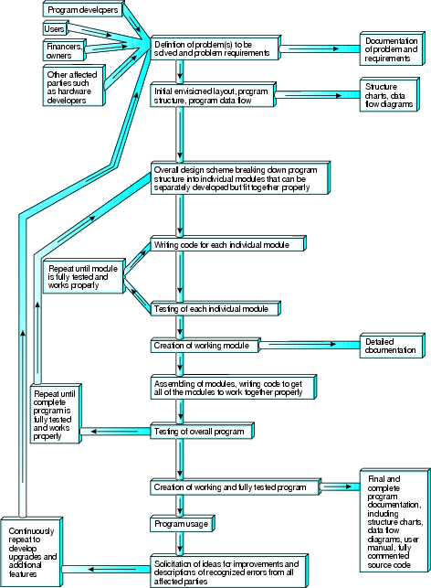
CSC1510 Computer Principle & C Programming

Slide 30
Top-down Modular Design
Begins by defining the main module of the software
Then sub-modules are developed
Each module is less complex than the whole (upper level one)
Modules are called functions in C
Can be divided into
  Library functions: Already included with C language
  User-defined functions: Custom-made by C programmer
Notes:
定义软件的主模块
每个模块都不如整个模块（上层一个模块）复杂
用户定义的函数：由C程序员定制

Slide 31

Program Development
Objective: Create an executable file (.exe)
A modern C programming development environment will:
  Allowing user to edit text (create C source code)
  Preprocessing source code
  Compiling source code and indicating any possible errors
  Linking object code from (3) with library (other object codes)
Programming Process:
C Library
Compiling
System
Coding
Compile
Linking
*.c
*.h
*.obj
*.exe
Edit
Compile
Link
Execute
*.obj

Slide 32
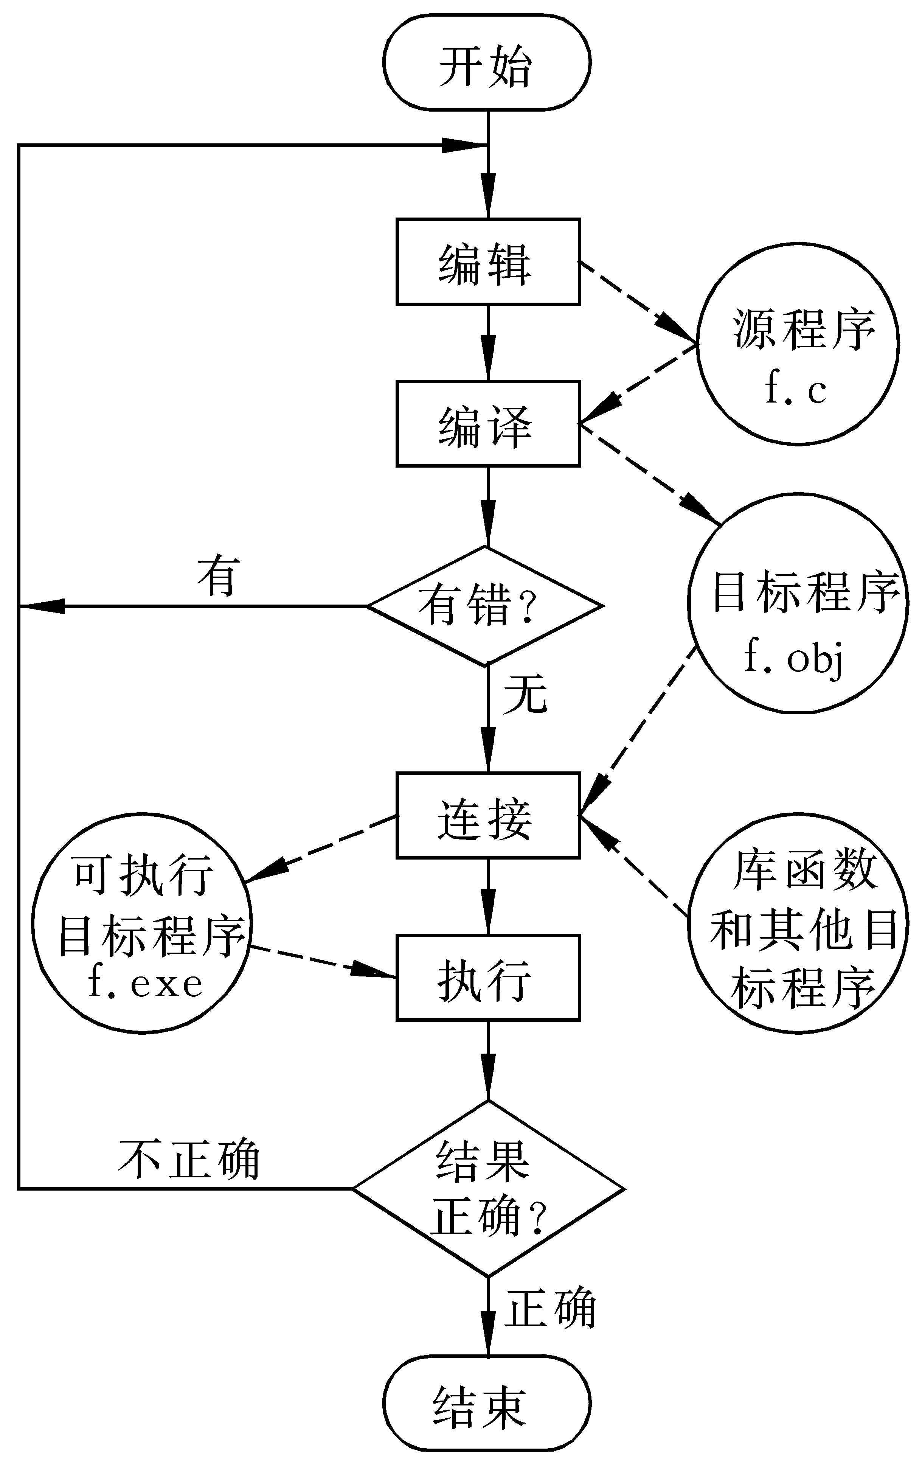

Slide 33

Program
Line No Code
01 /*L1_1.C - In this book, the source for Lesson x_y is Lx_y.c */
02 #include <stdio.h> /* This is an include directive */
03 void main(void)
04 {/*The purpose of this program is to print one
05 statement to the screen */
06 printf("This is C!");
07 }
Output

Slide 34
Program
Line No Code
01 /*L1_1.C - In this book, the source for Lesson x_y is Lx_y.c */
02 #include <stdio.h> /* This is an include directive */
03 void main(void)
04 {/*The purpose of this program is to print one
05 statement to the screen */
06 printf("This is C!");
07 }
Comment : Notes describing a
particular portion of your program

Slide 35
Program
Line No Code
01 /*L1_1.C - In this book, the source for Lesson x_y is Lx_y.c */
02 #include <stdio.h> /* This is an include directive */
03 void main(void)
04 {/*The purpose of this program is to print one
05 statement to the screen */
06 printf("This is C!");
07 }
Preprocessor directives: Essential to
every program

Slide 36
Program
Line No Code
01 /*L1_1.C - In this book, the source for Lesson x_y is Lx_y.c */
02 #include <stdio.h> /* This is an include directive */
03 void main(void)
04 {/*The purpose of this program is to print one
05 statement to the screen */
06 printf("This is C!");
07 }
Name of program body, actual program
to be executed will be placed here

Slide 37
Program
Line No Code
01 /*L1_1.C - In this book, the source for Lesson x_y is Lx_y.c */
02 #include <stdio.h> /* This is an include directive */
03 void main(void)
04 {/*The purpose of this program is to print one
05 statement to the screen */
06 printf("This is C!");
07 }
Braces: Mark the beginning & end of a program body

Slide 38
Program
Line No Code
01 /*L1_1.C - In this book, the source for Lesson x_y is Lx_y.c */
02 #include <stdio.h> /* This is an include directive */
03 void main(void)
04 {/*The purpose of this program is to print one
05 statement to the screen */
06 printf("This is C!");
07 }
Statements that instruct computer to print a message

Slide 39
Program
Line No Code
01 /*L1_1.C - In this book, the source for Lesson x_y is Lx_y.c */
02 #include <stdio.h> /* This is an include directive */
03 void main(void)
04 {/*The purpose of this program is to print one
05 statement to the screen */
06 printf("This is C!");
07 }
All statement must ends with semicolon ;

Slide 40
Further Exploration
Q: Can we use both uppercase and lowercase letters to write C code?
A: Yes!
  C language distinguishes between lower- and uppercase letters, i.e. ‘main’ is different from ‘Main’
  Both main and printf must be written in lowercase letters
Notes:
C语言能区分大小写字母吗？大小写是有区别的，是不同的

Slide 41
Further Exploration
Q: Is it necessary to use different lines in writing code?
A:
  You have the freedom to write C code at any row or column you like
  E.g.
  #include <stdio.h>void main(void){printf("This is C!");}
  or
  #include<stdio.h>void
  main( void ) {
  printf
  ( "This is C!" ) ;
  are both valid
Notes:
C语言代码行是很灵活，但是我们强调要培养编辑代码的风格，便于很清楚的看到代码行之间的关系

Slide 42
Programming style
void main( )
{
int i , j , sum;
sum=0;
for(i=1; i<10;i++)
{
for(j=1;j<10;j++)
{
sum+=i*j ;
}
}
printf(“%d\n”,sum);
}
Suggestions:
Indent(缩进)
{ } alignment（对齐）
More comments
Suitable blank lines

Slide 43
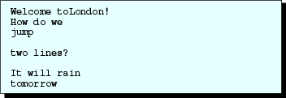
1.7 Formatting Output
04 printf("Welcome to");
05 printf("London!");
06 printf("\nHow do we\njump\n\ntwo lines?\n");
07 printf("\n");
08 printf("It will rain\ntomorrow\n");
Output
Notes:
人机界面要友好

Slide 44
Basic Structure of C Program
# preprocessing directives
//The preprocessing statements are generally placed in front
void main(void)
{
statement 1; /*Program statement sequence*/
statement 2;
statement 3;
statement 4;
...
}

Slide 45
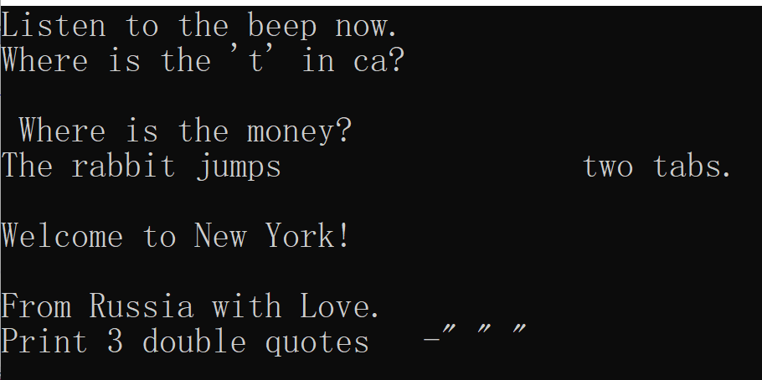
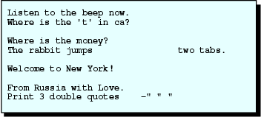
1.8 More Escape Sequences
04 printf("Listen to the beep now. \a");
05 printf("\nWhere is the 't' in cat\b?\n\n");
06 printf("I earned $50 \r Where is the money?\n);
07 printf("The rabbit jumps \t\t two tabs.\n\n");
08 printf("Welcome to \
09 New York!\n\n");
10 printf("From " "Russia \
11 with " "Love.\n");
12 printf("Print 3 double quotes -\" \" \" \n");
Output

Slide 46
1.8 More Escape Sequences
Doing back space
04 printf("Listen to the beep now. \a");
05 printf("\nWhere is the 't' in cat\b?\n\n");
06 printf("I earned $50 \r Where is the money?\n);
07 printf("The rabbit jumps \t\t two tabs.\n\n");
08 printf("Welcome to \
09 New York!\n\n");
10 printf("From " "Russia \
11 with " "Love.\n");
12 printf("Print 3 double quotes -\" \" \" \n");

Slide 47
1.8 More Escape Sequences
Line
01
02
03 {
04 printf("Listen to the beep now. \a");
05 printf("\nWhere is the 't' in cat\b?\n\n");
06 printf("I earned $50 \r Where is the money?\n);
07 printf("The rabbit jumps \t\t two tabs.\n\n");
08 printf("Welcome to \
09 New York!\n\n");
10 printf("From " "Russia \
11 with " "Love.\n");
12 printf("Print 3 double quotes -\" \" \" \n");
13 }
Moving cursor to start column
Output

Slide 48
1.8 More Escape Sequences
Line
01
02
03 {
04 printf("Listen to the beep now. \a");
05 printf("\nWhere is the 't' in cat\b?\n\n");
06 printf("I earned $50 \r Where is the money?\n”);
07 printf("The rabbit jumps \t\t two tabs.\n\n");
08 printf("Welcome to \
09 New York!\n\n");
10 printf("From " "Russia \
11 with " "Love.\n");
12 printf("Print 3 double quotes -\" \" \" \n");
13 }
Concatenate two strings
Output

Slide 49
1.8 More Escape Sequences
03 {
04 printf("Listen to the beep now. \a");
05 printf("\nWhere is the 't' in cat\b?\n\n");
06 printf("I earned $50 \r Where is the money?\n);
07 printf("The rabbit jumps \t\t two tabs.\n\n");
08 printf("Welcome to \
09 New York!\n\n");
10 printf("From " "Russia \
11 with " "Love.\n");
12 printf("Print 3 double quotes -\" \" \" \n");
13 }
Print double quotes
Output

Slide 50
Table 1.4
Character escape sequences
Escape
Sequence Meaning Result
\0 Null character Terminates a character string
\a Alert/bell Generates an audible or visible alert
\b Backspace Moves back one space on the current line
\f Form feed Moves to start of the next logical page
\n New line Linefeeds to next line
\r Carriage return Moves to initial position of the current line
\t Horizontal tab Moves to next horizontal tabulation position
\v Vertical tab Moves to next vertical tabulation position
\0ddd Octal constant integer constant of base 8 ddd digits 0-7
\xddd Hexadecimal constant integer constant base 16, where
\Xddd ddd represents decimal digits, and a–f or A–F represent values of 10 through 15 respectively
\\ Backslash Displays a backslash
\' Single quote Displays a single quote
\" Double quote Displays a double quote
\% Percent Displays a percent character

Slide 51
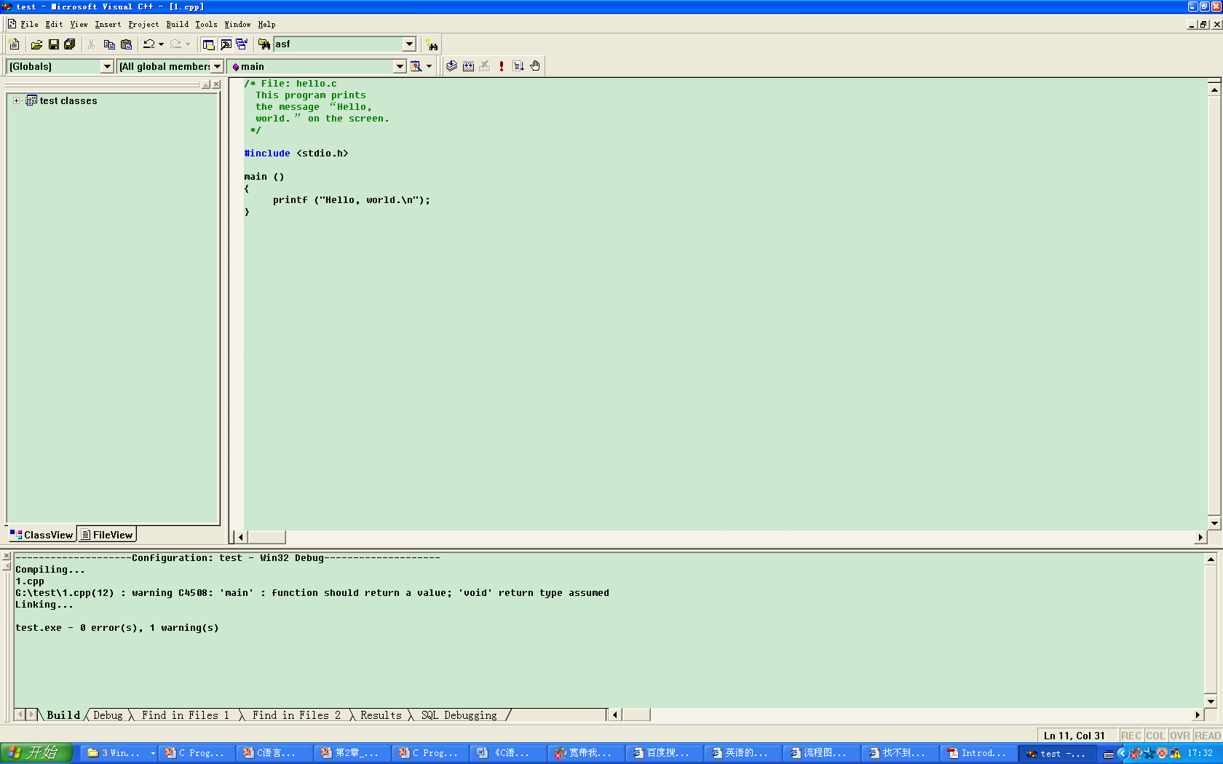
Compile it

Slide 52
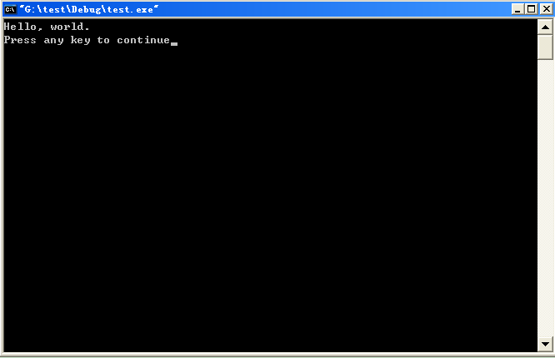
Run it

Slide 53
A program to add two numbers
e.g sum = n1 + n2, How to get sum?
void main ()
{
int n1, n2, sum ;
n1 = 23 ; n2 = 89 ;
sum = n1 + n2 ;
printf(“sum is %d \n”, sum) ;
}
/*main function*/
/*variables declaration */
/* assignment */
/*assignment expression */
/*output*/
statement
block

Slide 54
void main ()
{
int n1, n2, sum ;
n1 = 23 ; n2 = 89 ;
sum = n1 + n2 ;
printf(“sum is %d \n”, sum) ;
}
How to add any two numbers?
10011011
10100101
01100011
10101010
11111111
00000000
11100011
10100010
????????
????????
????????
????????
????????
????????
地址为1000
1001
1002
1003
1004
1005
1006
1007
n1=23
&n1 ?
void main( )
{
int n1, n2, sum;
scanf ( “%d, %d”, &n1, &n2);
sum = n1+n2;
printf (“%d,%d,%d\n”,a,b,sum);
}
地址为1010
1011
1012
1013
1014
n2=89
&n2 ?
输入方法是 66,88

Slide 55
Outline
Overview of Programs and Algorithms
Overview of C Language
    Programming Language
    Characteristics of C
    Essential Elements
    Simple Programming Examples
How to do programming?
    Programming Process
    Programming Environment
    Programming style

Slide 56
Programming Environment for C
Integrated Development Environment:
  Turbo C 2.0、Turbo C++ 3.0、Visual C++…

Slide 57
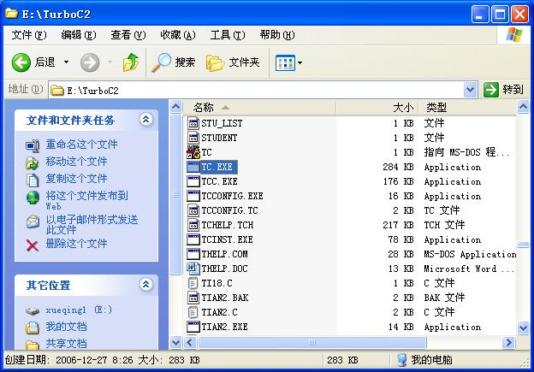
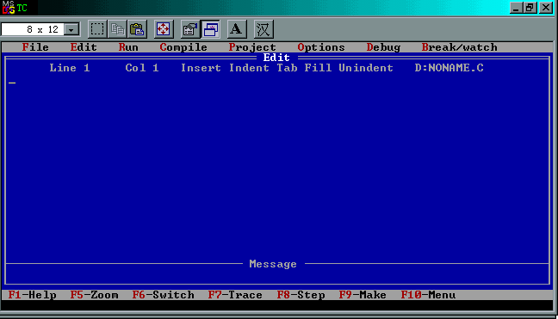

Turbo C
Status
Main menu
Edit window
Message window
Hot-key

Slide 58
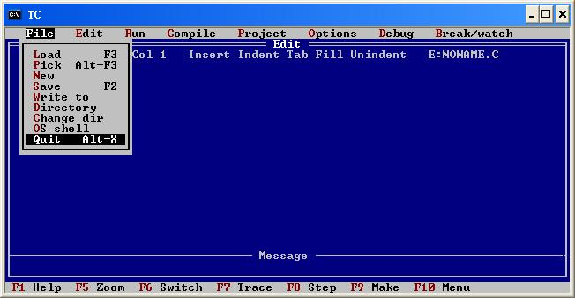
Turbo C
目录
1）功能键 F10 或 Alt + F/E/R…(红色)
2）移动方向键进行选择
3) Esc 退出菜单
退出 Turbo C :
1）菜单: File | Quit
2）快捷键: Alt+“X”

Slide 59
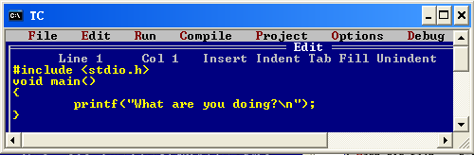
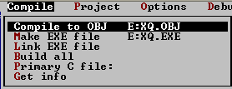
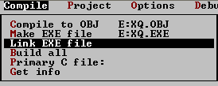

Turbo C
step1: coding
step2: compile *.c ,get *.objfile
step3: linking *.obj and lib function and other files
step4: run *.exe

Slide 60
Visual C++
Visual C++ 是 Microsoft 针对 C、C++ 和 C++/CLI 编程语言推出的
可视化面向对象开发环境
使用帮助：
  http://msdn.microsoft.com/zh-cn/visualc/ee340952.aspx

Slide 61
How to program with C in
Visual C++ 6.0

Slide 62
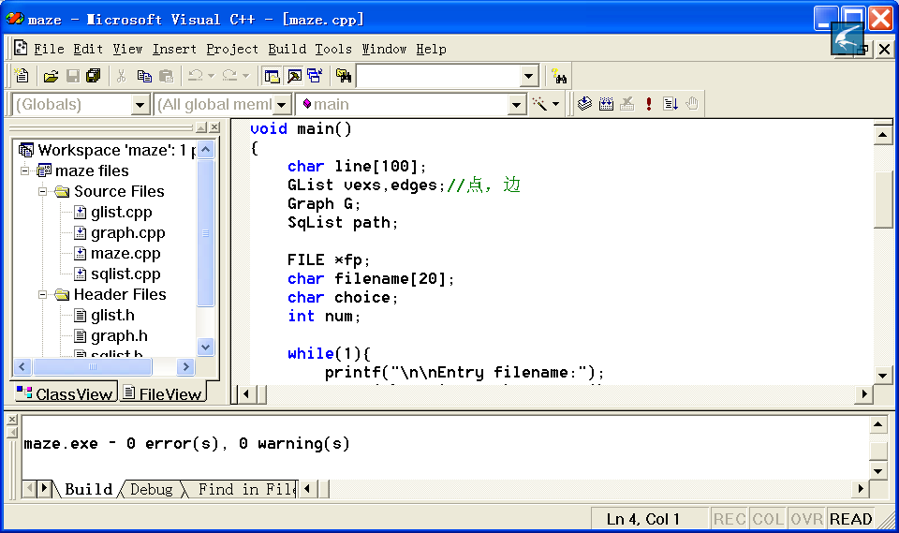
Visual C++ 6.0
Visual C++6.0 provide application wizard with which a simple application can be construct automatically.

Slide 63
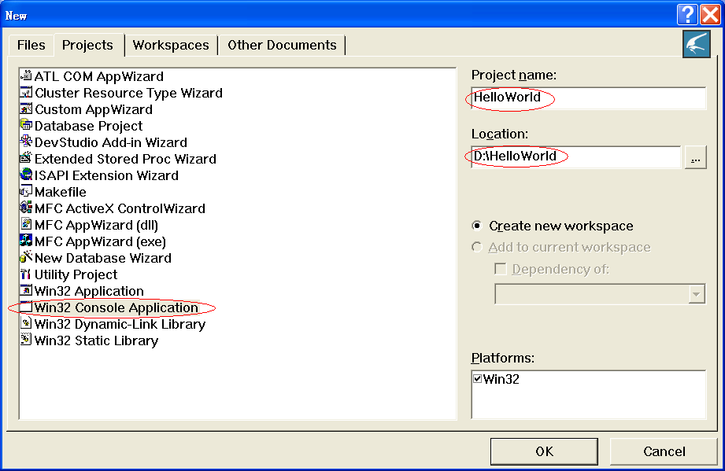
The first C program：HelloWorld
Start Visual C++ 6.0,then chose file->new->projects->Win32 Console Application
项目
名称
选择创建控制台程序
保存
位置

Slide 64
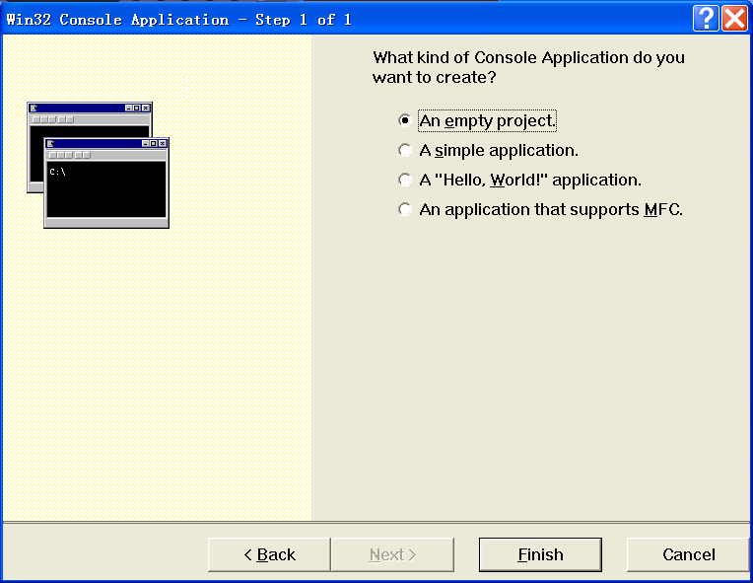
Win32 console application is created by AppWizard
Choose to construct a new project(An empty project)

Slide 65
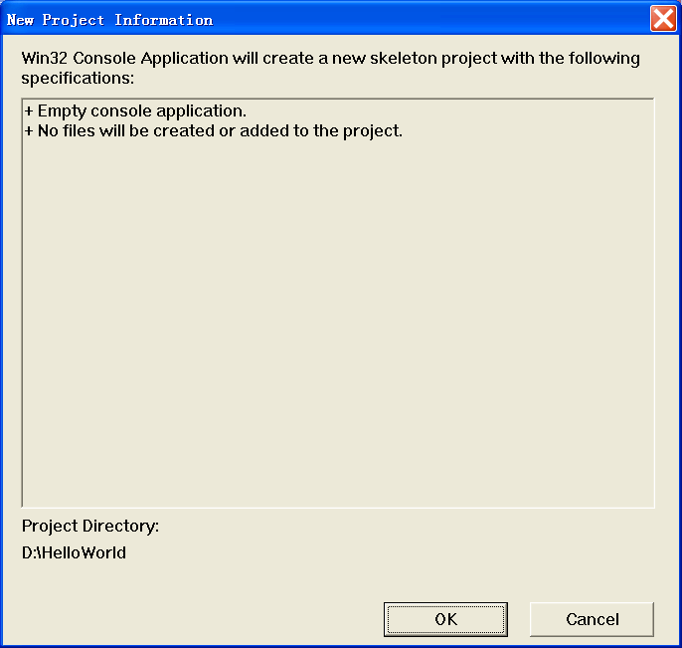
Win32 console application is created by AppWizard
Project construction information

Slide 66
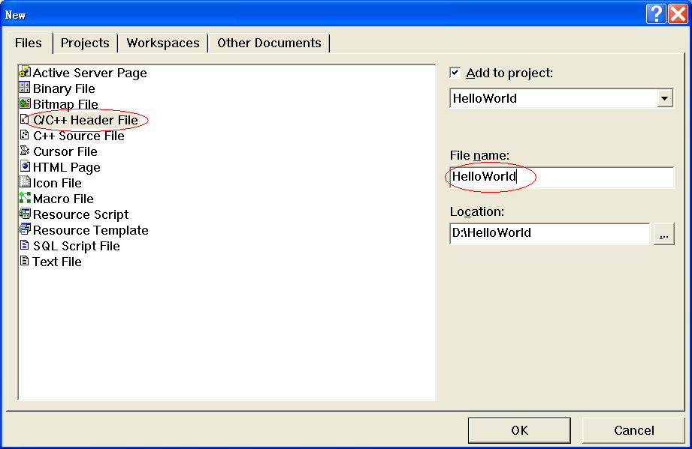
Add *.h file to the project
Chose file->new->file->C/C++ Header File
添加头文件名

Slide 67
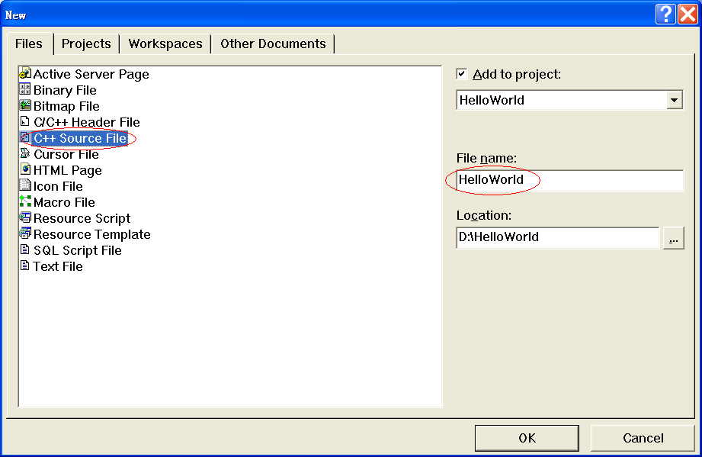
Add *.cpp (*.c) file to the project
Choose menu file->new->file->C/C++ Source File
添加源文件名

Slide 68
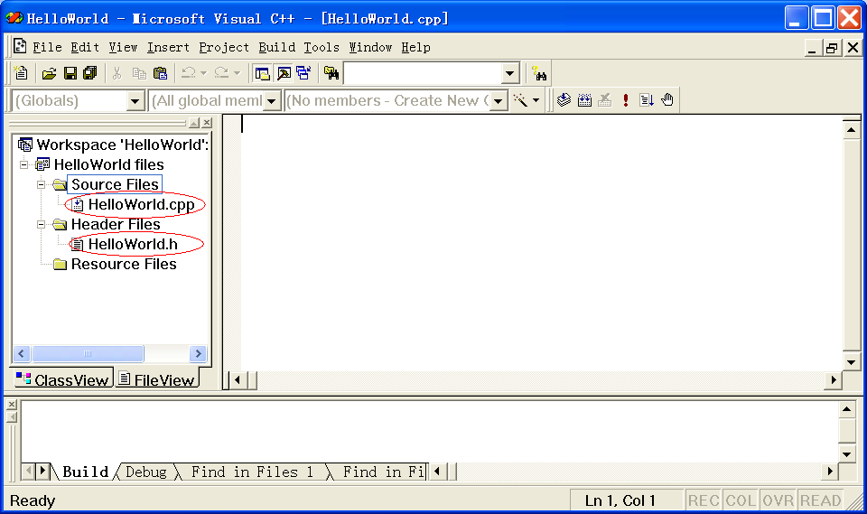
Project file view
A project including a .h file and a .cpp file

Slide 69
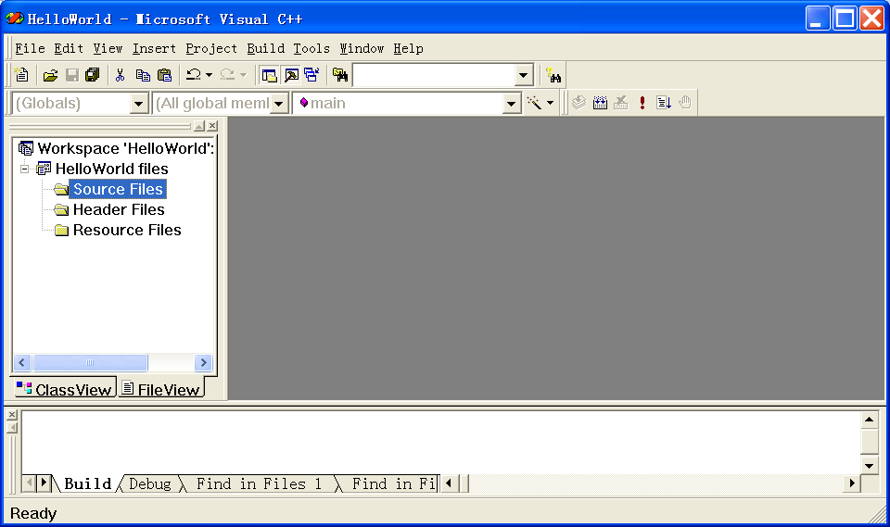
Directly add existed .h or .cpp files
Choose Source Files or header files in File View plate

Slide 70
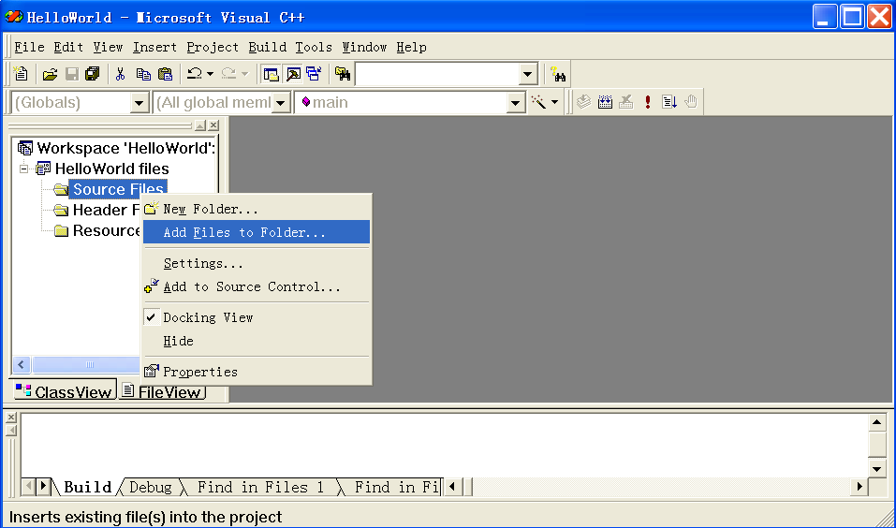
Directly add existed .h or .cpp files
Click right key and choose Add Files to Folder…

Slide 71
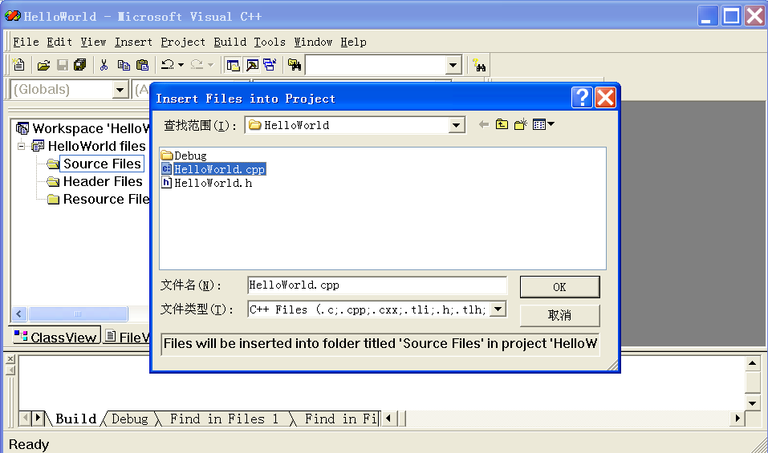
Directly add existed .h or .cpp files
Choose .h，.cpp files from dialogue box

Slide 72
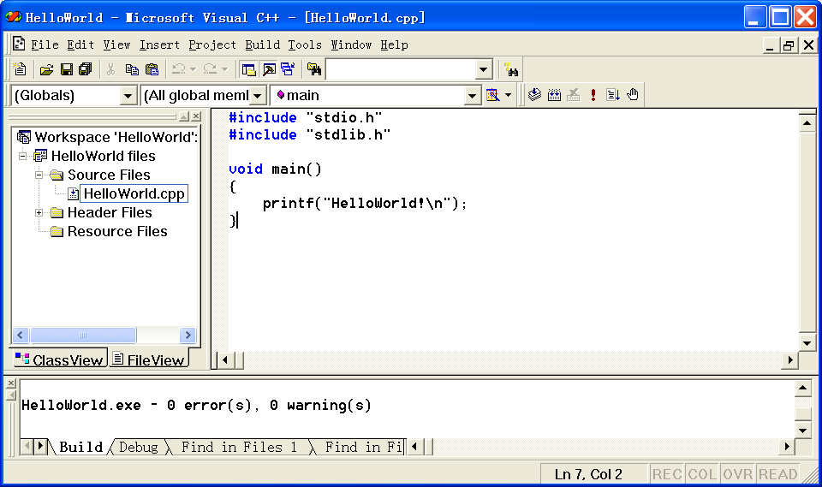
Add C code to the project

Slide 73
Compile
After compiling, the *.obj file is created for linking
Choose Build→Compile，or shortcut keys “Ctrl+F7” or click the Compile button directly.

Slide 74
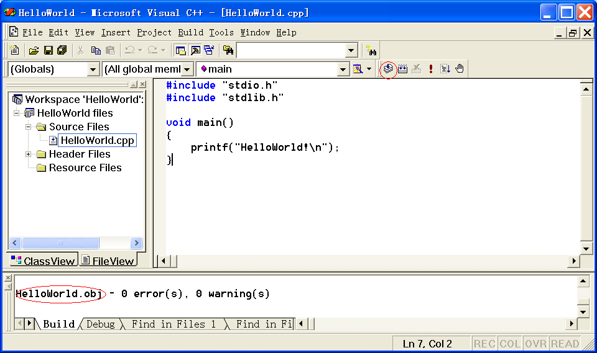
Compile(编译)
编译按钮
生成.obj文件

Slide 75
Link
After Linking, the *.exe file is created for executing
Choose Build→Build，or shortcut keys “F7” or click the Build Button directly.

Slide 76

Link
连接按钮
生成.exe文件

Slide 77
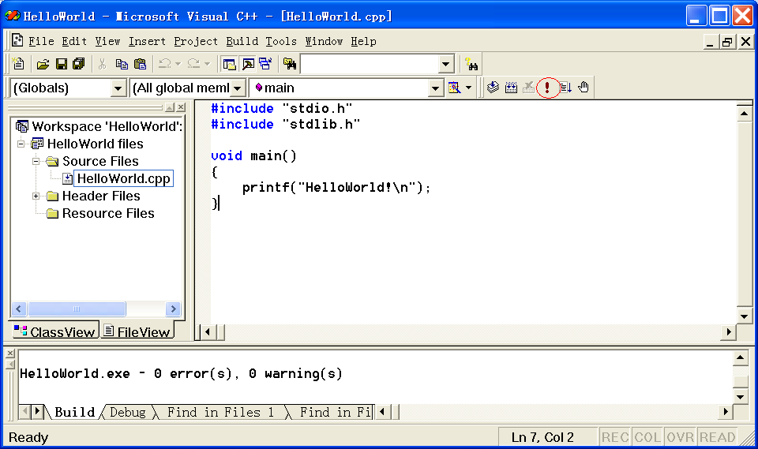
Execute
After successful linking, choose Build→Execute or shortcut keys “Ctrl+F5” or directly click Execute Button
运行按钮

Slide 78
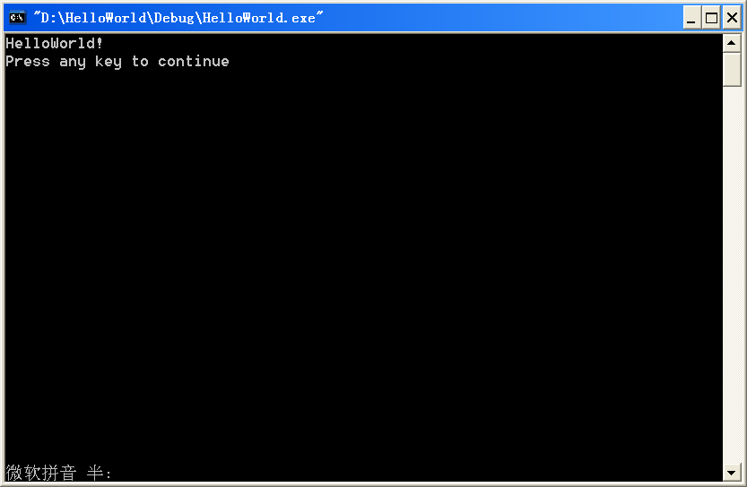
Output

Slide 79
TERMS
Compiler 编译系统Instruction 指令
Syntax 文法（语法）Source file 源文件preprocessor 预处理
Object file 目标文件
Keyword 关键字
Statement 语句

Slide 80
TERMS (cont.)
Variable 变量
Constant 常量
Operator 运算符
Operand 运算分量
Expression 表达式
Control flow 控制流程
Loop 循环
Initialization 初始化
Binary 二进制
Octal 八进制
Hexadecimal 十六进制

Slide 81
Thank you!
Q & A

